Slide 1
AESG
Automotive Engineering Summer Germany 2025

Slide 2

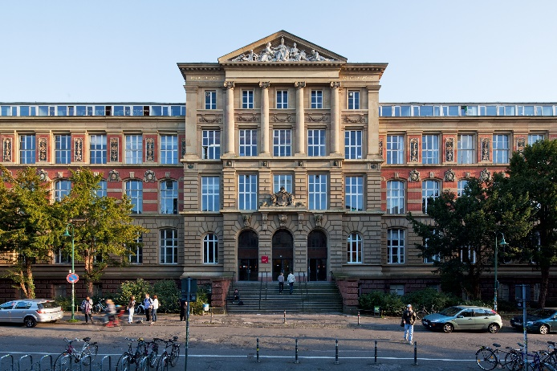


Do you know Darmstadt?
Vibrant Student City
Home of one of Germanys Top 3 Universities in Mechanical Engineering
20 minutes from Frankfurt

Slide 3
Exchange Program
For whom ?
When
  Undergraduate students in their final year
  Graduate students
  During US summer term 2025
  Starts end of May
  10 weeks long
What is it about ?
  3 automotive related classes will be offered
  Total of 6 US credit points
  Credits can be fully transferred to your home university
Something special ?
  No German language skills requirements. Whole program will be in English

Slide 4
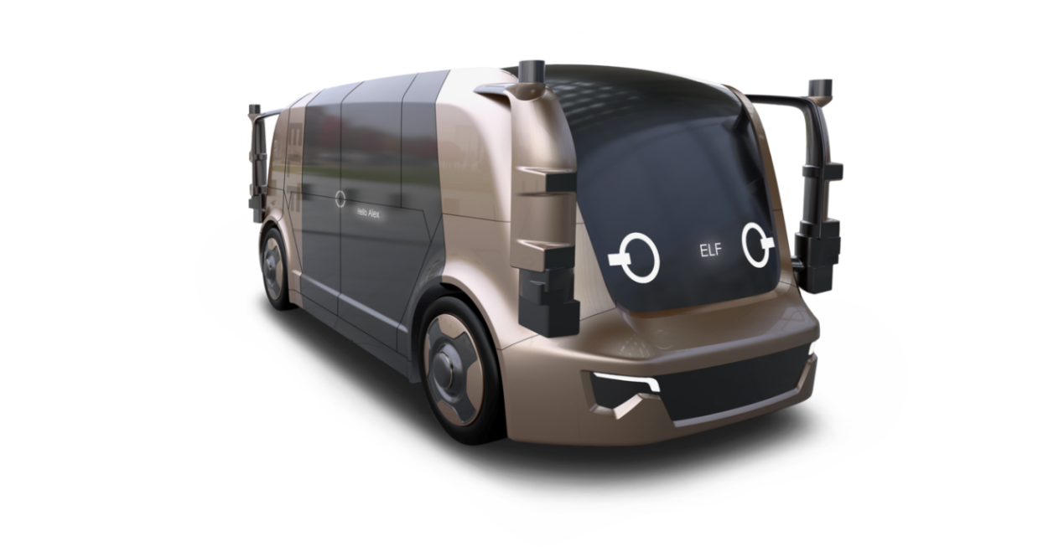
Classes
Trends in Automotive Engineering
Different fields of automotive engineering
Lectures about cutting edge technology
  Automated Driving
  Neuromorphic Perception
  AI for Assistance Systems for Trams
  ….

Slide 5
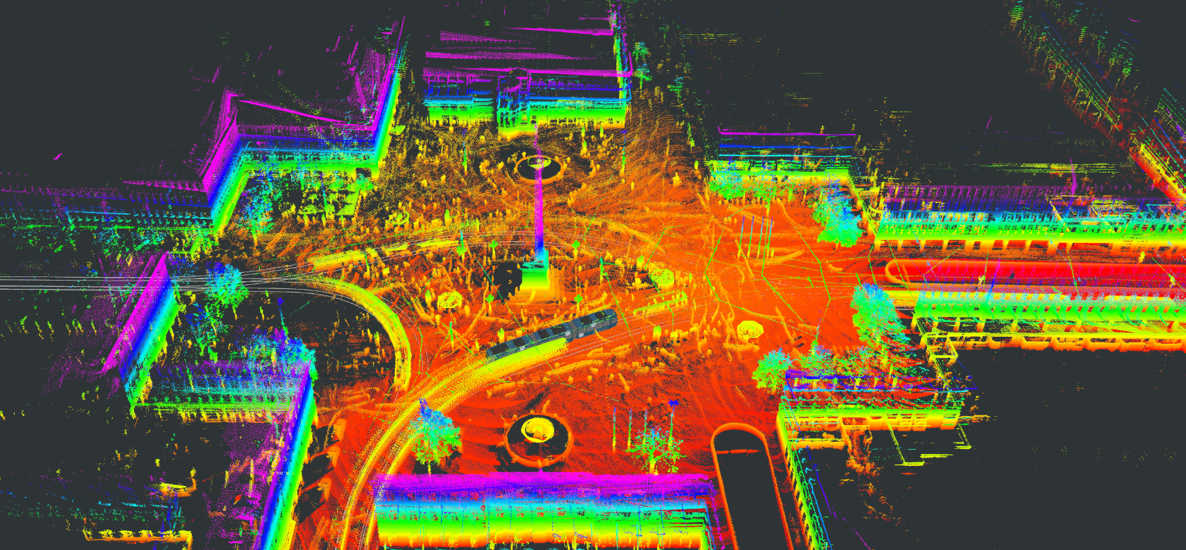
Classes
Advanced Design Project
Group project on automated driving or sustainable vehicle concepts

Slide 6
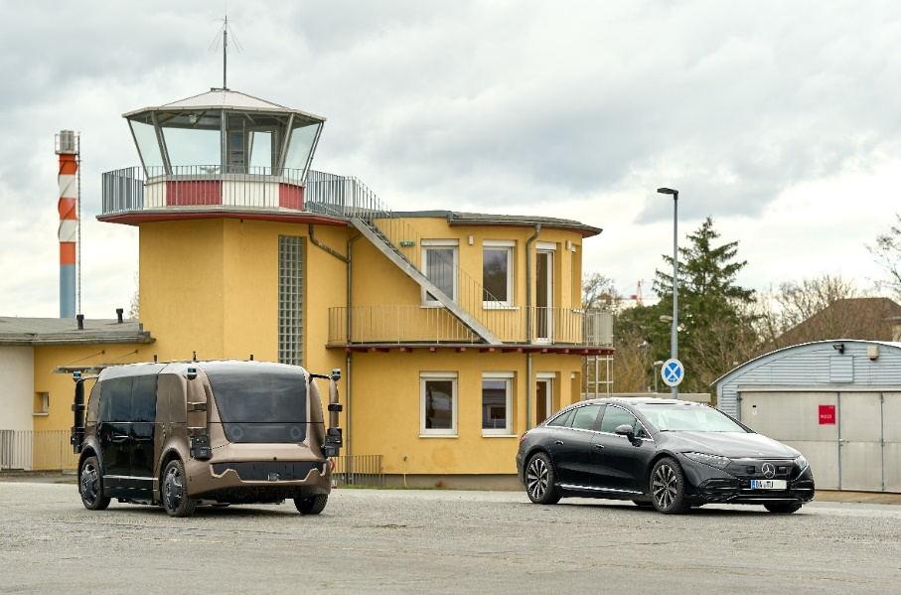
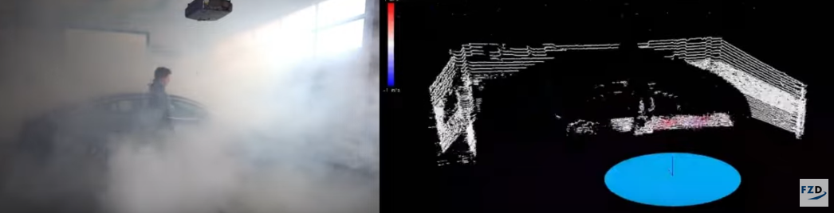
Classes
Automotive Engineering Lab
Real driving and sensor experiments
Put theoretical knowledge into practice

Slide 7
Classes
Class Overview
  All held in English & with German students
  Total of 6 Credit Hours transferable (Undergraduate AND Graduate)
Course Title | Type | Exam
Trends in Automotive Engineering | Lecture | written exam
Advanced Design Project | Lecture & Lab | report & presentation
Automotive Engineering Lab | Lecture & Lab | report & presentation

Slide 8
Time Schedule
Orientation
Trends in Automotive Engineering
Automotive Engineering Lab
Advanced Design Project
1 Week
7 Weeks
3 Weeks
May 26th
August 1st
Weekends are free! (e.g. for traveling)

Slide 9

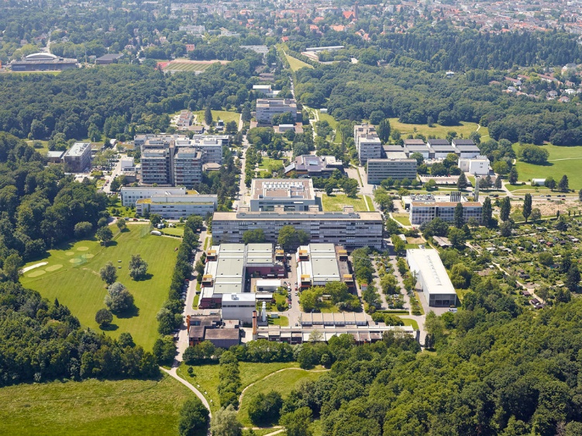

Motivation
Why to participate?
Studying automotive technology in Germany
Studying at one of Germany‘s best universities for mechanical engineering
Transfer credits for your degree
Boost your career ‘having studied in Germany’
PhD Candidate
Internship
AESG

Slide 10
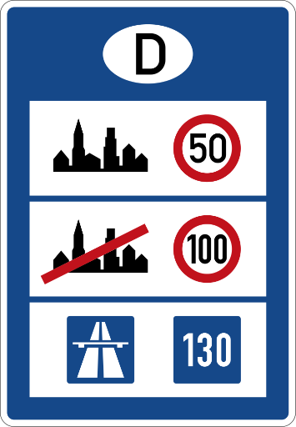

Motivation
And furthermore…
No speed limit on the Autobahn
Global experience
Opportunity to travel within Europe
  Rome, Paris, London, Amsterdam etc.
What else
You stay enrolled at your home university
Additional Cost: Flight + program fee (≈ $ 2.900)
Includes housing
Including local public transportation & two trips

Slide 11
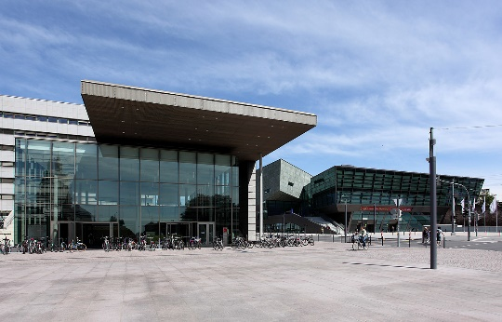
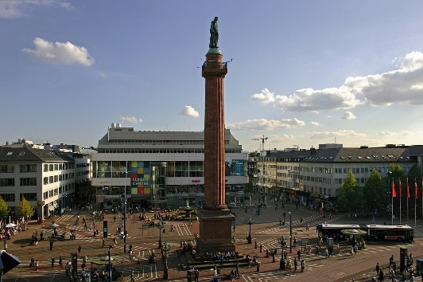

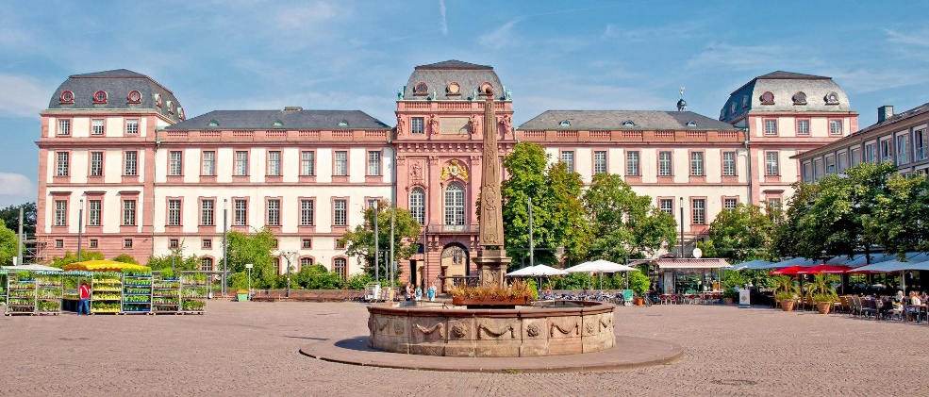

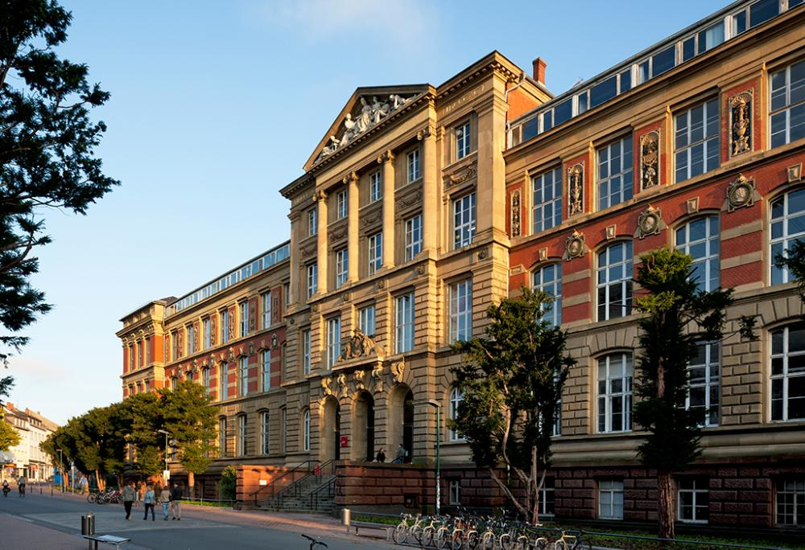
Traveling in Germany
Darmstadt
Heidelberg
Berlin

Slide 12
See you in Germany!
www.fzd.tu-darmstadt.de/aesg

